Slide 1
CDO Council Survey Results
January 2021

Slide 2
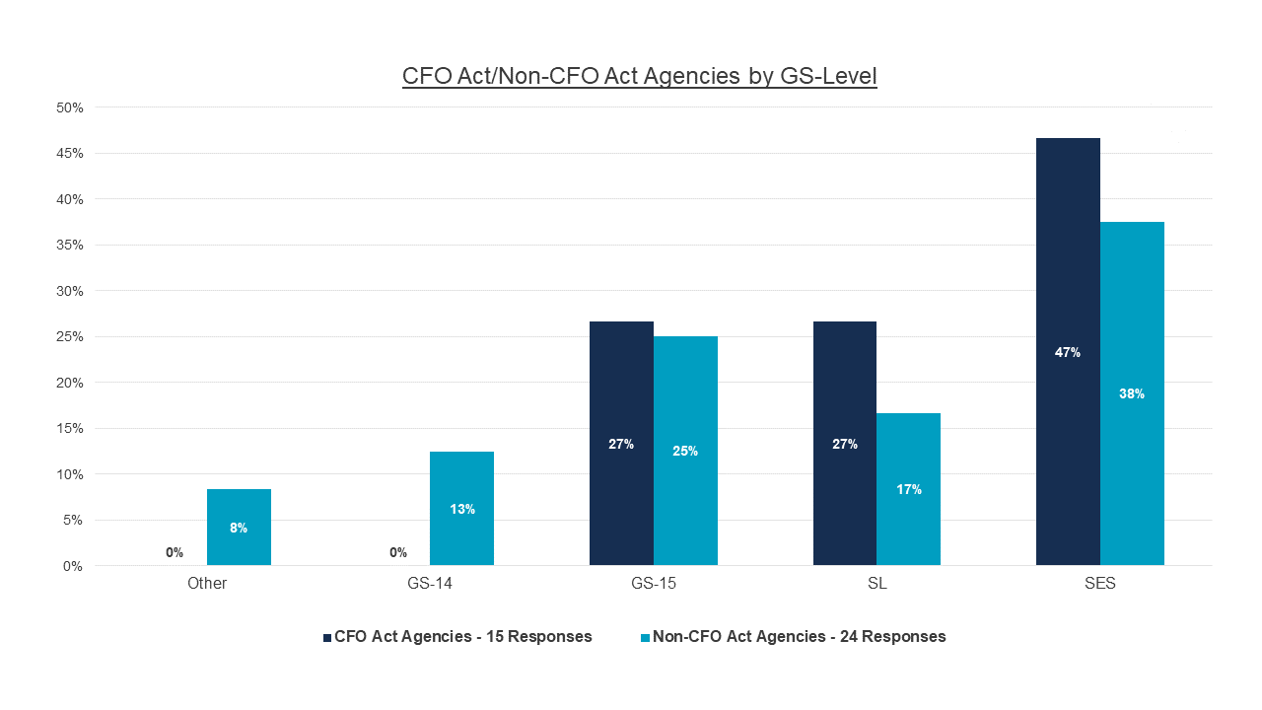
CDOs’ Grade Levels
Q9
Notes:
Removed decimals and switched SL and GS-15 order

Slide 3
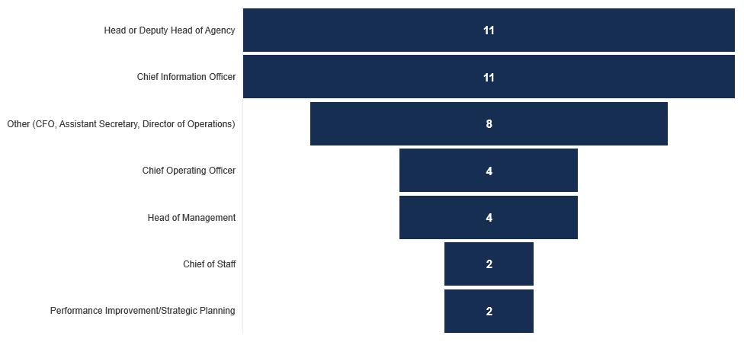
Where do CDOs Report in Their Agencies?
Q7
Notes:
Removed cascading colors, added more information for “other category”, and used funnel chart to more clearly show different in volume

Slide 4
Is CDO your primary role?
56.4%
43.6%
Q3
Notes:
Removed hats and updates colors to keep consistent with CFO vs Non CFO color choice

Slide 5
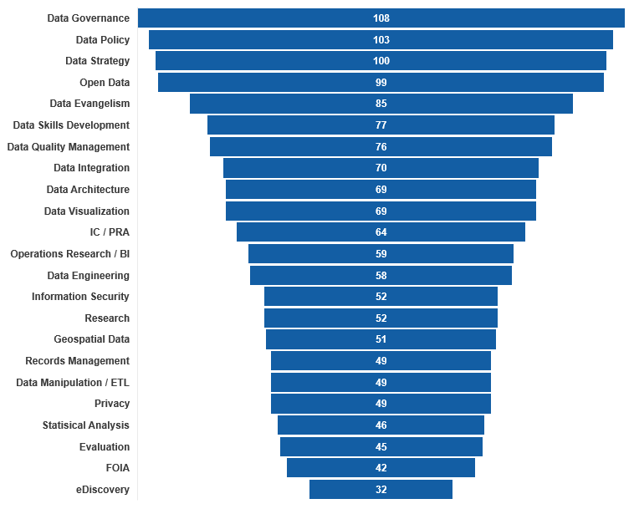
Convergence on Areas of Responsibility
Note: The highest possible score was 117 based on all survey responses.
Q6
Notes:
Removed cascading colors and used same funnel chart as slide 7 to show difference in volume

Slide 6
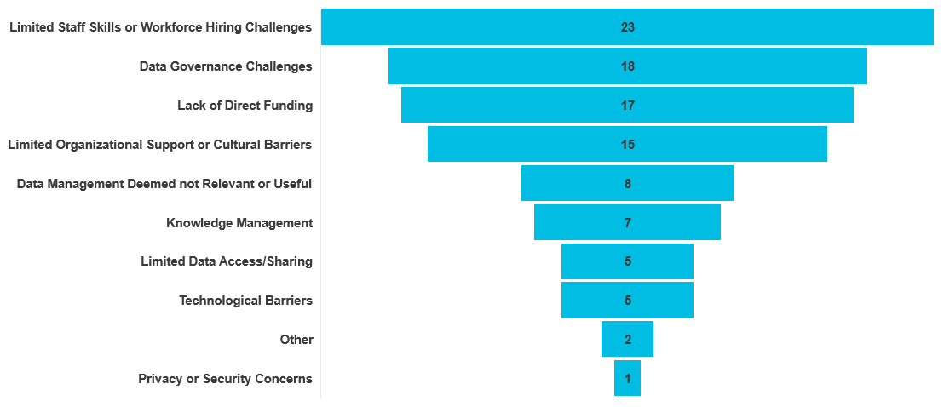
Common Obstacles
Q6
Notes:
Removed cascading colors and used same funnel chart as slide 7 to show difference in volume

